Slide 1







DIGITAL BIOMARKERS
FUTURE
DIGITAL BIOMARKERS
FUTURE
DIGITAL BIOMARKERS
SUMMARY
PARKINSON
INTRODUCTION
BIOMARKERS
BIOMARKERS
DATA COLLECTION
DATA COLLECTION

Slide 2













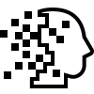

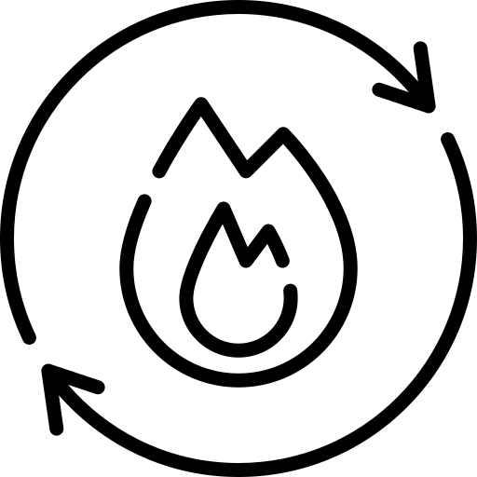

DIGITAL BIOMARKERS
FUTURE
Glucose
Cholesterol
Hemoglobin
Blood
(short for "biological markers") are measurable indicators of a biological state, condition, or process in the body. They are often used in medical science and research to detect diseases, monitor disease progression, assess the effects of treatment, or predict outcomes.
BIOMARKERS
DATA COLLECTION
Biomarker
Protein
Genetic
SUMMARY
Amyloid
Tumor
PARKINSON
Image
INTRODUCTION
Metabolic
Environmental Exposure

Slide 3
DIGITAL BIOMARKERS
FUTURE
Physical Activity and fitness
“a characteristic that is objectively quantified and assessed as an indicator of normal biological functions, pathological states, or pharmacological responses to therapeutic interventions”
Atkinson, A. J. et al. Biomarkers and surrogate endpoints: Preferred definitions and conceptual framework. Clin.
Pharmacol. Ther. 69, 89–95 (2001).
BIOMARKERS
DATA COLLECTION
DIGITAL BIOMARKER
Cardiovascular Health
Sleep Patterns
SUMMARY
PARKINSON
INTRODUCTION
Behavioral Health
Respiratory Health
Neurological and Cognitive Health

Slide 4
DIGITAL BIOMARKERS
FUTURE
BIOMARKERS
DATA COLLECTION
DIGITAL DEVICES
SENSORS
RAW DATA
ALGORITHM
DIGITAL BIOMARKERS
SUMMARY
PARKINSON
INTRODUCTION
ACTIVE
PASSIVE
PERSON INTENTIONALLY INTERACTS WITH THE DEVICE.
CAN INCREASE PATIENT ENGAGEMENT AND AWARENESS
COLLECT MORE DATA POINTS
BY SIMPLY WEARING A DEVICE
STEPPING ON A BATHMAT
TALKING
TYPING ON A PHONE
ENABLES THE CONTINUOUS MONITORING

Slide 5
DIGITAL BIOMARKERS
FUTURE
ACTIVE
PASSIVE
PERSON INTENTIONALLY INTERACTS WITH THE DEVICE.
CAN INCREASE PATIENT ENGAGEMENT AND AWARENESS
COLLECT MORE DATA POINTS
BY SIMPLY WEARING A DEVICE
STEPPING ON A BATHMAT
TALKING
TYPING ON A PHONE
ENABLES THE CONTINUOUS MONITORING
BIOMARKERS
DATA COLLECTION
DIGITAL DEVICES
SENSORS
RAW DATA
ALGORITHM
DIGITAL BIOMARKERS
SUMMARY
PARKINSON
INTRODUCTION
BIO-SIGNALS
OPTICAL SIGNALS
ELECTROCHEMICAL SIGNALS
MULTI-MODAL SIGNALS
ELECTRICAL SIGNALS

Slide 6
DIGITAL BIOMARKERS
BIO-SIGNALS
OPTICAL SIGNALS
ELECTROCHEMICAL SIGNALS
MULTI-MODAL SIGNALS
ELECTRICAL SIGNALS
FUTURE
ACTIVE
PASSIVE
PERSON INTENTIONALLY INTERACTS WITH THE DEVICE.
CAN INCREASE PATIENT ENGAGEMENT AND AWARENESS
COLLECT MORE DATA POINTS
BY SIMPLY WEARING A DEVICE
STEPPING ON A BATHMAT
TALKING
TYPING ON A PHONE
ENABLES THE CONTINUOUS MONITORING
BIOMARKERS
DATA COLLECTION
DIGITAL DEVICES
SENSORS
RAW DATA
ALGORITHM
DIGITAL BIOMARKERS
SUMMARY
PARKINSON
INTRODUCTION
COMPUTERIZED ALGORITHMS INTERPRET SENSOR DATA
DE-NOISING
ENHANCEMENT
PREDICTION LAYER

Slide 7
DIGITAL BIOMARKERS
FUTURE
Digital biomarkers will deeply transform healthcare by driving innovations in disease prevention, diagnostics, treatment, and monitoring.
Game-changing for patients, healthcare professionals, and pharmaceutical companies.
BIOMARKERS
DATA COLLECTION
DIGITAL BIOMARKER
SUMMARY
PARKINSON
INTRODUCTION

Slide 8
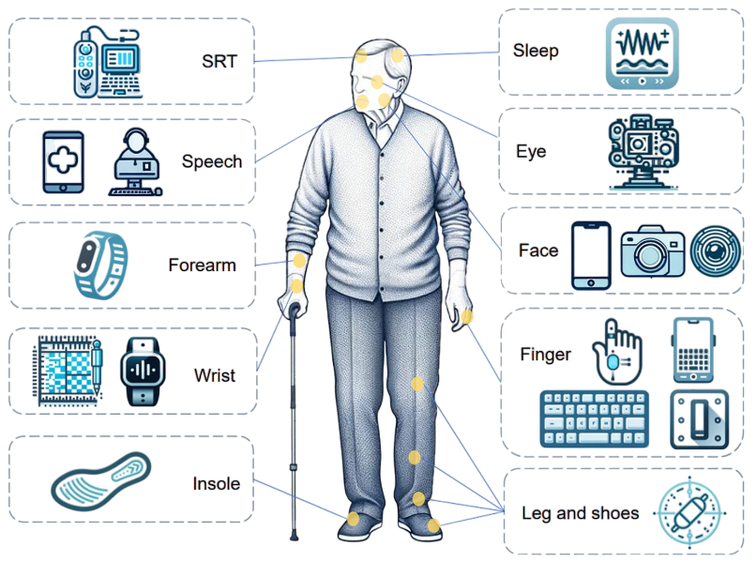
Serial Reaction Time (SRT)
Digital biomarkers:
Response time after an event occurs.
Reaction time
Detection Devices:
Serial Response Box
A personal computer with a 33-cm color monitor connected to a four-button box
SUMMARY
PARKINSON
INTRODUCTION

Slide 9
Digital biomarkers
Volume, velocity, acceleration, and frequency of hand positions
Acceleration and angular velocity
Continuous inertial sensor data
Detection Devices
A Leap Motion Controller (LMC)
Apple Watch and its application MM4PD
Wrist
SUMMARY
PARKINSON
INTRODUCTION

Slide 10
SLEEP
Classification
EEG headband
Nighttime respiratory signals
Wearable device
Smart bed
Digital Biomarkers
Total sleep time, sleep efficiency, wakefulness, light sleep duration, etc.
SUMMARY
PARKINSON
INTRODUCTION

Slide 11
Gait and balance
Classification
Ankle
Footwear
Insole
FoG
Digital Biomarkers
Stride length, stride duration, gait speed
Pressure values of the sensors, acceleration and angular velocity
SUMMARY
PARKINSON
INTRODUCTION

Slide 12
1
2
3
4
CURRENT CHALLENGES
CHALLENGES
APPLICATION
COMPARE
GITHUB
This table summarizes key challenges faced in the realm of digital biomarkers.
CHALLENGE | DESCRIPTION | IMPACT
Data Privacy | Concerns regarding user data | Trust issues with users
Integration | Difficulty combining data sources | Hindered analysis capability
Validation | Lack of standardized methods | Inconsistent results
Interoperability | Systems not communicating effectively | Data silos
SUMMARY
PARKINSON
INTRODUCTION

Slide 13
APPLICATIONS
1
2
3
4
CHALLENGES
APPLICATION
COMPARE
GITHUB
Diagnosis
Prognosis
Therapeutic Monitoring
Risk Assessment
SUMMARY
PARKINSON
INTRODUCTION

Slide 14
BIOMARKERS VS DIGITAL BIOMARKERS
1
2
3
4
CHALLENGES
APPLICATION
COMPARE
GITHUB
Aspect | Biomarkers | Digital biomarkers
Definition | Measurable biological indicators of a biological state. | Measurable physiological or behavioral data collected using digital devices
Accessibility | Requires specialized equipment and healthcare professionals. | Accessible through consumer grade device (e.g. smartphone, fitness trackers)
Personalization | Limited, based on standardized clinical parameters. | Highly personalized, tracks individual behaviors and physiological trends.
Cost | Expensive | Generally lower cost after initial device purchase.
SUMMARY
PARKINSON
INTRODUCTION

Slide 15
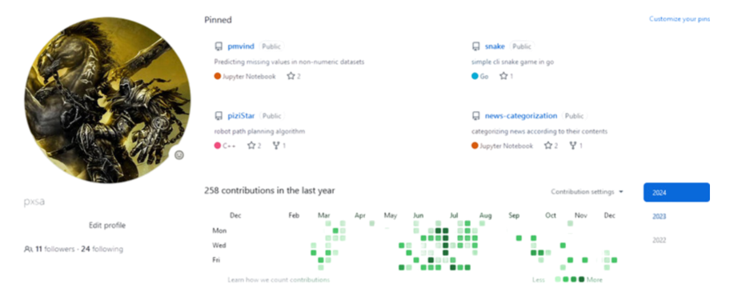
GITHUB
1
2
3
4
CHALLENGES
APPLICATION
COMPARE
GITHUB
https://github.com/pxsa/Digital-Biomarkers
SUMMARY
PARKINSON
INTRODUCTION

